Slide 1
Working with the Web Part Property Pane
Building custom property pane fields

Slide 2

Building custom property pane fields
Add custom property pane field
Creating custom property pane controls
Notes:
In this unit, you'll learn about custom property pane controls for client-side web parts.

Slide 3
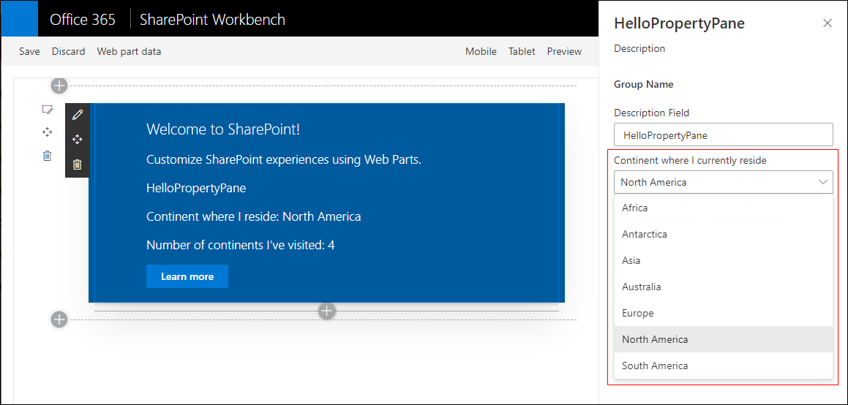
Overview
Property pane supports the following field types out-of-the-box
Label
Textbox
Multi-line Textbox
Checkbox
Dropdown
Link
Slider
Toggle
Custom
Also possible to create your own custom field types
Notes:
The SharePoint Framework API for client-side web parts includes the following property pane field controls you can use in your custom web parts:
- label
- textbox
- checkbox
- dropdown
- link
- slider
- toggle
Developers can also create custom field controls for more complex scenarios. For example, maybe you want to implement a cascading dropdown where the selection of the first control impacts the available choices on the second selector.

Slide 4
Implementing custom property pane fields
Define an interface in your web part that includes one or more target properties
Import PropertyPaneCustomField field type in the web part class
PropertyPaneCustomField field type is available as a modules in the @microsoft/sp-property-pane library
Notes:
To implement a custom property pane field control, you will first import the `PropertyPaneCustomField` class from the **@microsoft/sp-property-pane** class.
Next, add a property to your web part's interface and map it to the field control. Do this the same way you map one of the provided controls to a property: specify the property by name as the first argument in the control:

Slide 5
Implementing custom property pane fields
// Web Part: create a render method for the custom field
private _customFieldRender(elem: HTMLElement): void {
elem.innerHTML = '<div><h1>This is a custom field.</h1></div>’;
}
// Add custom field definition in a groupFields array
protected get propertyPaneSettings(): IPropertyPaneSettings {
return {
pages: [
{
header: { description: strings.PropertyPaneDescription},
groups: [
{
groupName: strings.BasicGroupName,
groupFields: [
PropertyPaneCustomField('customField', {
onRender: this._customFieldRender.bind(this)
}),
]
} ] } ]
}
}
Notes:
The `PropertyPaneCustomField` field control enables developers to define a custom rendering for the control. To do this, implement a method that accepts a single `HTMLElement` parameter. This element is a reference to the `<div>` where the control is rendered on the page.
Finally, bind the function to the `onRender` property on the `PropertyPaneCustomField` properties:

Slide 6
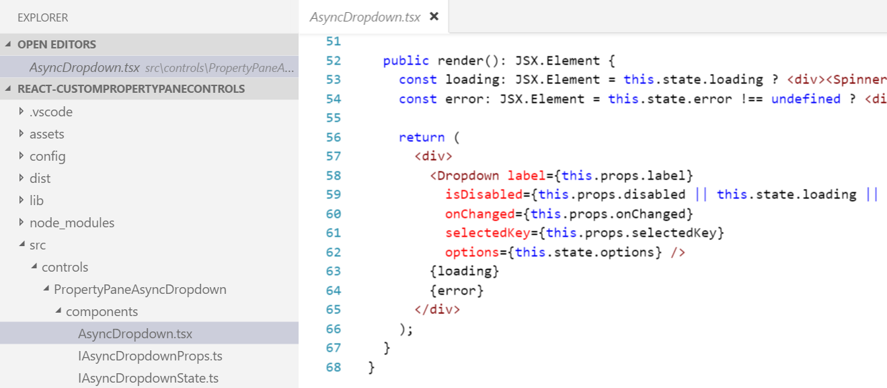
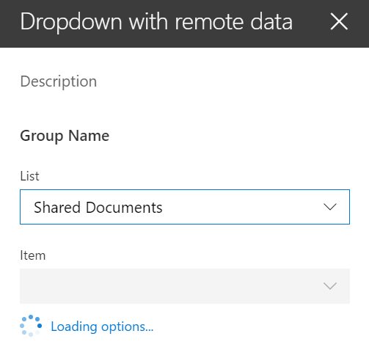
Creating custom property pane controls
When out-of-the-box property pane controls don’t meet your needs you can create your own custom controls
Creating custom controls promotes code reusability
https://github.com/SharePoint/sp-dev-fx-webparts/tree/master/samples/react-custompropertypanecontrols
Notes:
The `PropertyPaneCustomField` field control enables developers to control how a the controls renderer. all the code for rendering the control is in the web part where its used.
While this solution will work for many one-off scenarios, you may have more complicated business requirements. In this scenario, you can create custom property pane controls that give you more control and are reusable across web part projects.
To use a custom field control in your web part, you will just import it into the project and add a reference to it like the included field controls:

Slide 7
Demo Building custom property pane fields

Slide 8

Summary
Add custom property pane field
Creating custom property pane controls

Slide 9
Reading further
Overview of the SharePoint Framework
https://docs.microsoft.com/sharepoint/dev/spfx/sharepoint-framework-overview
Make your SharePoint Client-Side Web Part Configurable
https://docs.microsoft.com/sharepoint/dev/spfx/web-parts/basics/integrate-with-property-pane
Build Custom Controls for the Property Pane
https://docs.microsoft.com/sharepoint/dev/spfx/web-parts/guidance/build-custom-property-pane-controls

Slide 10
Thank you.

